Slide 1

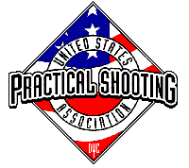
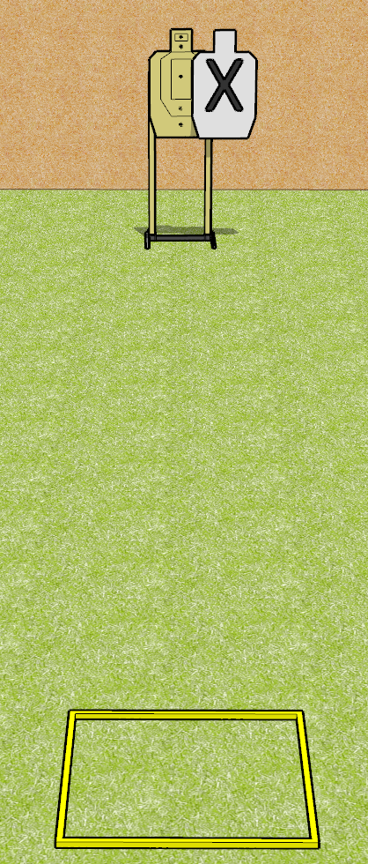
 | Dothan Gun Club – USPSA Match Weak Hand Bill Drill Course Designer : Drew Coleman
Round Count 12 rounds 1 USPSA target
Equipment List Shoot box

Slide 2
Weak Hand Bill Drill
Written Stage Briefing
Weak Hand Bill Drill is a 12 round, 60 point, Comstock speed shoot. There is 1 USPSA target, and the best 12 hits will score. The start signal is audible.
Handgun start position is in shooting box, wrists below belt. Handgun is loaded and holstered.
PCC start position is in shooting box, stock on belt. Loaded carbine is held with both hands safety on.
On start signal, engage target with 6 rounds, perform a mandatory reload, and then engage with 6 rounds weak hand only.

